Slide 1
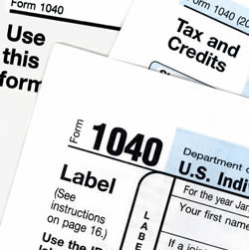
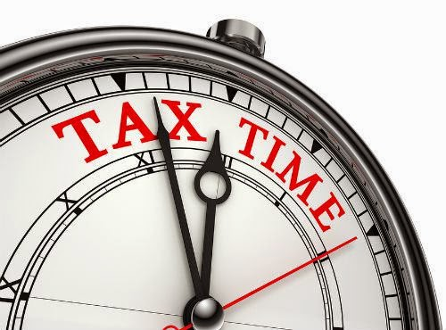
ATMB
TAX TIME TAX TIME TAX TIME TAX TIME
YOU TAKE CARE OF YOUR BUSINESS, WE TAKE CARE OF YOUR TAXES
Your Friendly Professional Income Tax and Bookkeeping Service
TAX FILING – INDIVIDUALS, SMALL BUSINESSES, NON PROFITS
MAXIMIZE DEDUCTIONS TO BOOST YOUR TAX REFUND
ELECTRONIC FILING FOR FASTER REFUND
COMPETITIVE PRICING WITH PERSONALIZED CUSTOMER CARE
ATMB SERVICES INC
6250 WESTPARK DR. SUITE 301, HOUSTON, TX 77057
TEL: (713)589-3320
web: www.atmbservices.com

